Slide 1

Module 4
Lecture 5
Introduction to Machine Learning:
Supervised Learning
Pull from upstream remote!
If you get a merge conflict on .gitignore, choose YOUR version
Sarah Groves, Ph.D.
Shayn Peirce-Cottler, Ph.D.

Slide 2
Where we are so far…
STEP 1: Learn about cancer (and a specific cancer type if desired!)
STEP 2: Explore the data-set (you will be given one)
STEP 3: Ask a question related to the data set that you are curious about
STEP 4: Visualize the data with dimensionality reduction (unsupervised)
STEP 5: Implement clustering, regression, or classification using Python/scikit-learn to answer the question (supervised)
STEP 6: Verify and validate the answer using ML metrics
STEP 7: Draw conclusions and reflect on the ethical implications
STEP 8: Communicate your question’s background, methods, conclusions, limitations, implications, and future work
Week 1
Due Thursday April 9 by class:
Cancer Hallmark ABM simulations activity
Due Friday April 10 midnight:
GitHub Check-in #1
Week 2
Due Tuesday April 14 by class:
Video comprehension quiz
Due SUNDAY APRIL 19 midnight:
GitHub Check-in #2
Week 3
Due SUNDAY APRIL 26 midnight:
GitHub Check-in #3
Week 4
Due Tuesday May 5 midnight:
Final Project
Presentations: May 5 2pm (Final exam block)

Slide 3
Project check-in- in class
Share with your team what you are planning for your project, including your project goal and the specific method you will use to answer it (classification or regression)
If you are not sure how to choose your target variable, now is a GREAT time to get advice!
The next team to present should first ask a question of the previous team
The team who went first should ask a question of the team that goes last
Group 2 asks a question
Group 2 asks a question
Group 1 asks a question
Group 1 presents
…
Group 2 presents
Group 3 presents
Group 7/8 presents

Slide 4
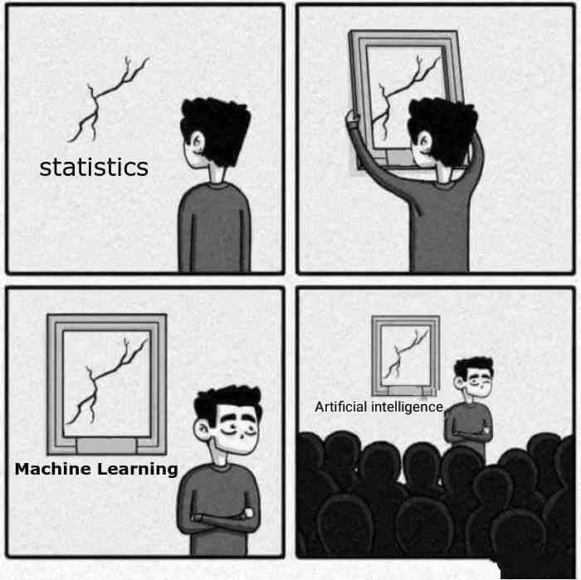
Supervised learning methods
I have “labeled” data
  I am trying to predict something about new data and have a dataset with the “true answer/label/target variable”
  Predicting survival from gene expression
  Predicting expression of one gene from another
  Predicting subtype/stage based on gene expression
Regression
  Linear regression
    Optimizing the SSE using gradient descent
Classification
  Logistic regression
    Optimizing logistic cost function
  SVMs
  Naïve Bayes
  Decision trees
https://scikit-learn.org/stable/supervised_learning.html

Slide 5
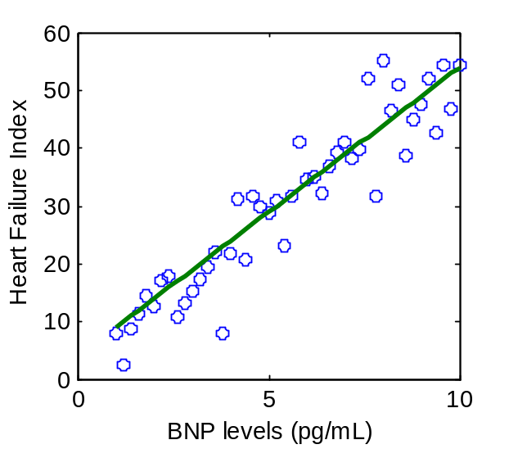
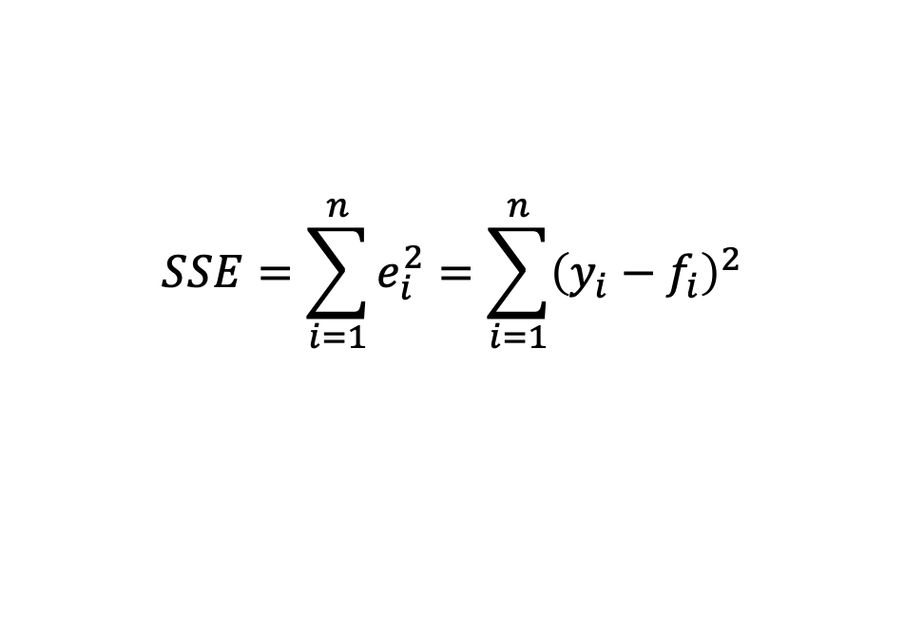


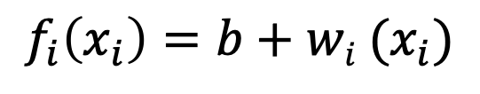
Linear regression (2.0)
Predict a number from infinitely many possible outputs
Goal: find the line (f) that best fits the data (xi, yi) by minimizing the sum of squared errors
$$SSE=\sum_{i=1}^{n}{e_{i}^{2}}=\sum_{i=1}^{n}{{\left(y_{i}−f_{i}\right)}^{2}}$$
$$f_{i}\left(x_{i}\right)=b+wi (x_{i})$$
Output variable (target)
Training set
Input variable (feature)
Learning algorithm
(gradient descent)
m = number of training examples (number of datapoints with x and y information)
$$x$$
$$f\left(x\right)=y$$
f_{i}
feature
prediction

Slide 6
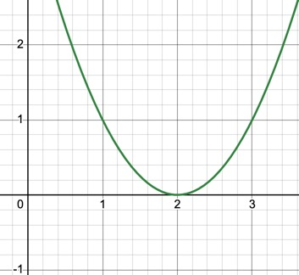
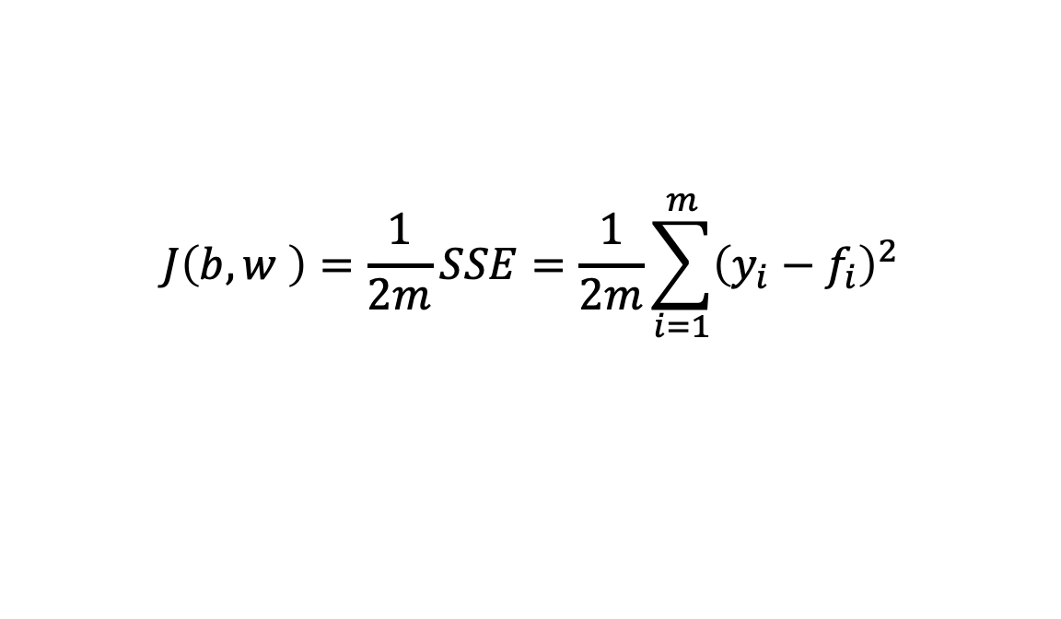
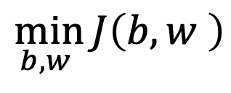
Linear regression (2.0): Optimizing a cost function
How well is our model doing? (And how can the computer make it better?)
Our model parameters: b, w
Our cost function is the average SSE:
GOAL:
$$J\left(b,w \right)=\frac{1}{2m}SSE=\frac{1}{2m}\sum_{i=1}^{m}{{\left(y_{i}−f_{i}\right)}^{2}}$$
J (cost function)
$$\min_{b,w }{J\left(b,w \right)}$$
Prediction (f(x)

Slide 7
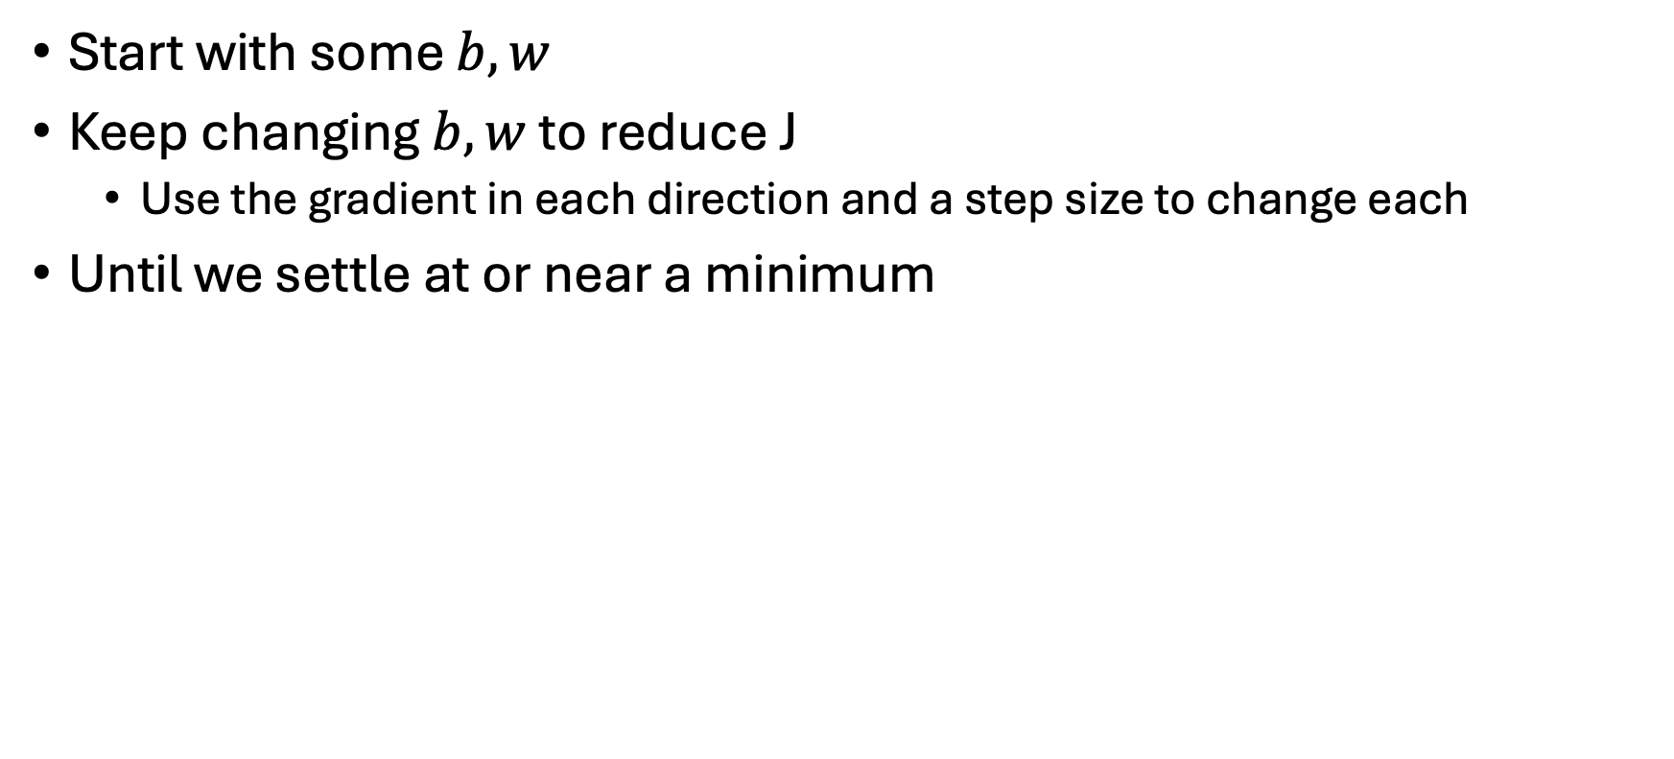
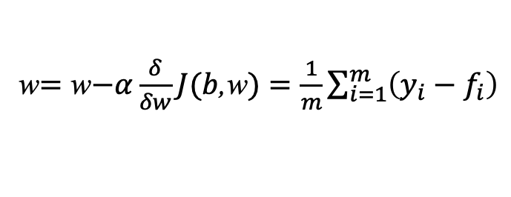
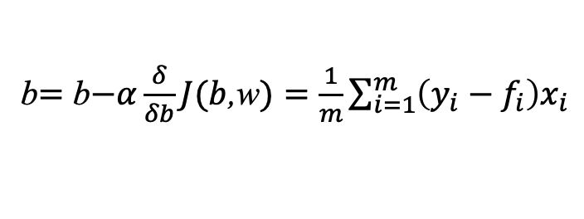

Linear regression (2.0): Gradient descent (optimization)
Start with some $b,w$
Keep changing$b,w$ to reduce J
  Use the gradient in each direction and a step size to change each
Until we settle at or near a minimum
Steepest descent (numerical method)
Gradient descent (ML implementation)
$$x_{i+1}=x_{i}+hf′(x_{i})$$
Updates (simultaneously):
b$=$ b$−α\frac{δ}{δb}J(b$,w$)=\frac{1}{m}\sum_{i=1}^{m}{\left(y_{i}−f_{i}\right)x_{i}}$
Proceed along the path of steepest descent, i.e. direction with the greatest negative change
  In 1D, there are only 2 ways to go
Smaller steps as xi approaches xmax
If h is too small, it will converge slowly
If h is too big, it may overshoot the maximum
w$=$ w$−α\frac{δ}{δw}J(b$,w$)=\frac{1}{m}\sum_{i=1}^{m}{\left(y_{i}−f_{i}\right)}$
⍺ = learning rate (step size)

Slide 8
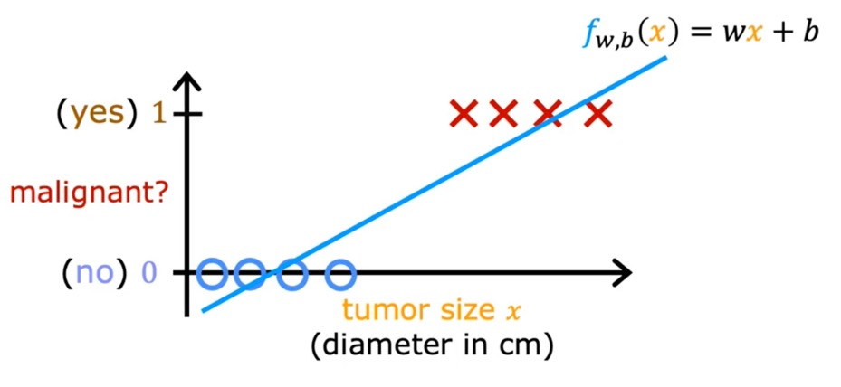
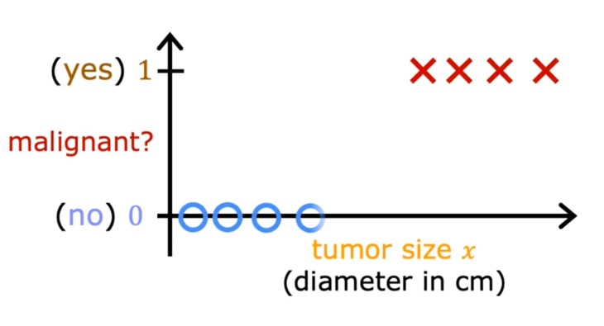
Classification
Binary classification: two possible classes
Predict a category from a small number of possible outputs
x
Linear regression with threshold?
What if we have a sample with very high tumor size?
Adapted from Coursera, Andrew Ng

Slide 9
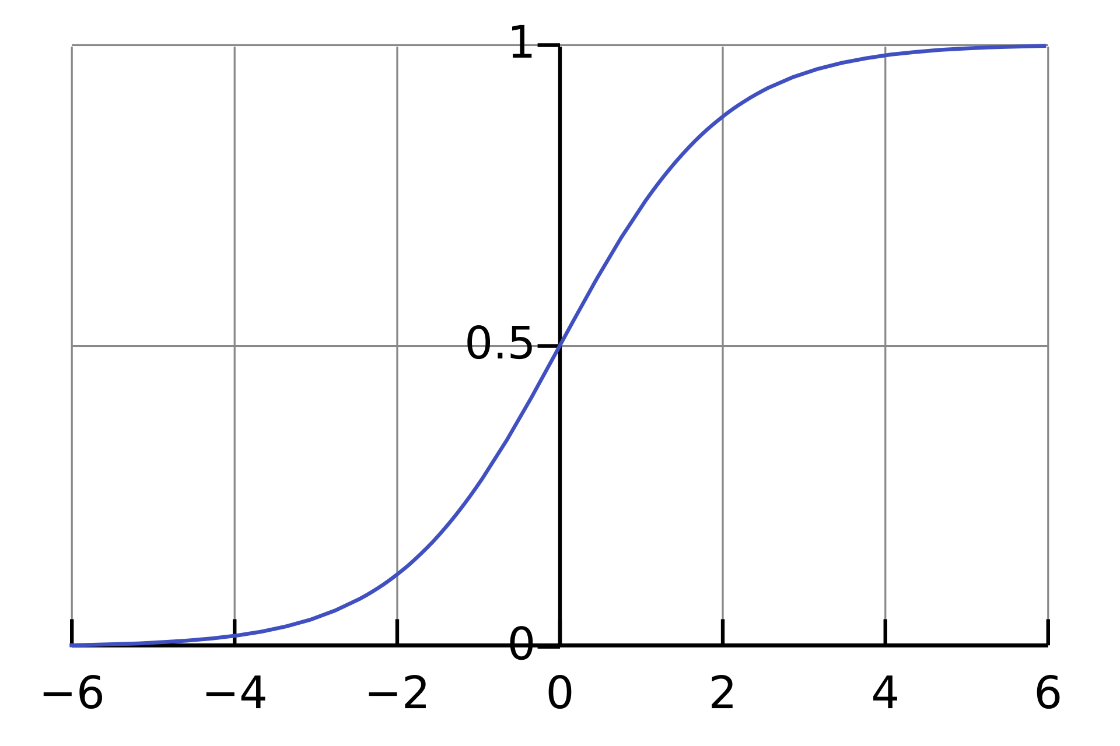

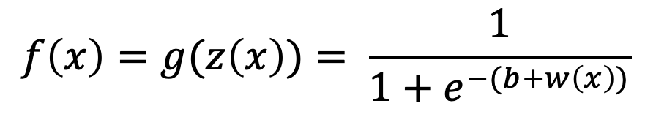
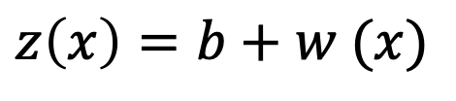
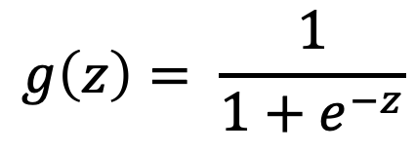
Logistic regression
f(x)
Sigmoidal/logistic function
$$g\left(z\right)= \frac{1}{1+e^{−z}}$$
$$z\left(x\right)=b+w (x)$$
$$f\left(x\right)=g(z\left(x\right))= \frac{1}{1+e^{−(b+w\left(x\right))}}$$
Outputs between 0 and 1
g(z)
When is f(x) ≥ 0.5?
When z ≥ 0
When b$+w(x)$ ≥ 0
z

Slide 10
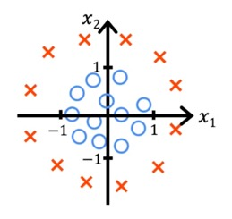
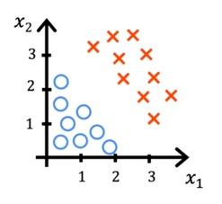

Decision boundary: where $z=0$
$$z\left(x\right)=b+wi (xi)$$
$$z\left(x\right)=0=x22+x12−1$$
$$z\left(x\right)=0=x1+x2−3$$
Output of function will still be 0 or 1! Now “inside” or “outside”
Notes:
X1 + X2 =3
X1^2 + X2^2 = 1

Slide 11
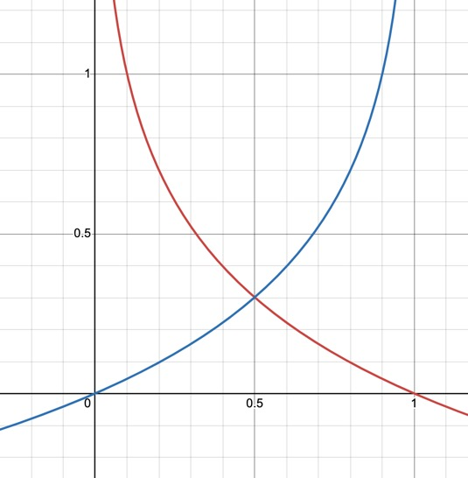
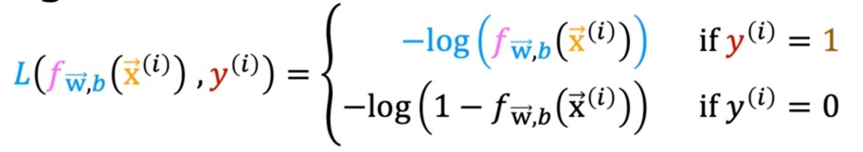
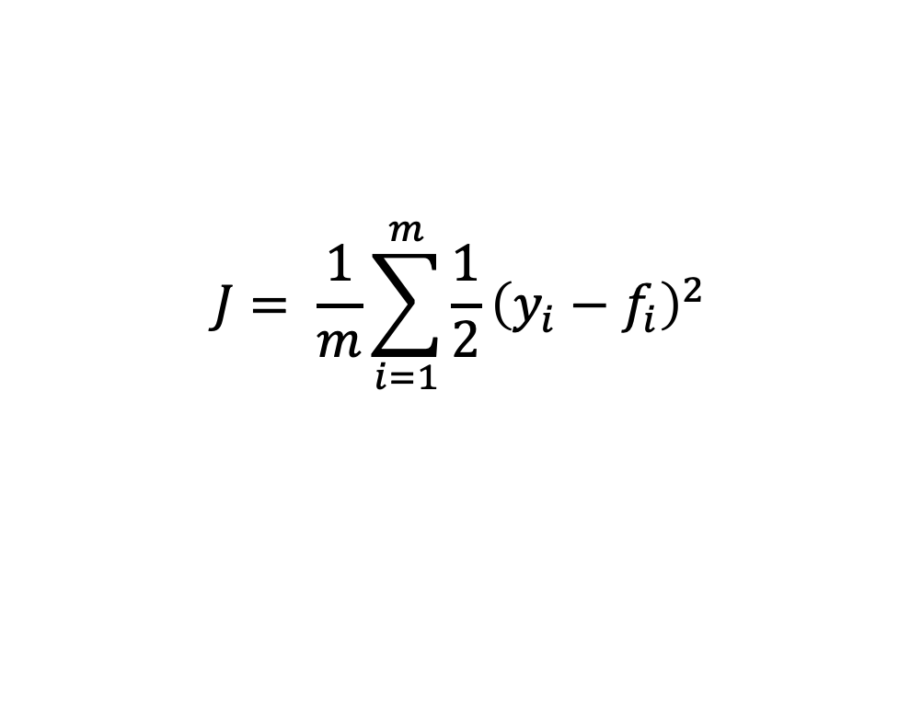
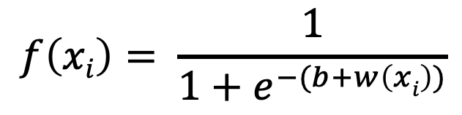
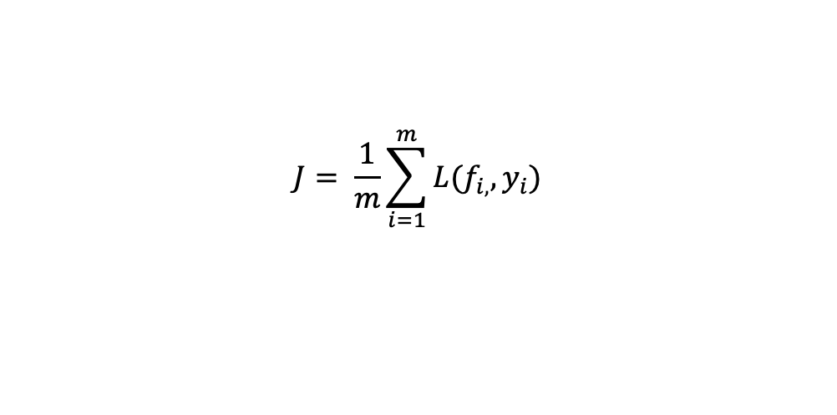
Cost function → logistic loss function
Linear regression
Cost function
Loss, L
$$J= \frac{1}{m}\sum_{i=1}^{m}{L(f_{i,},y_{i})}$$
$$J= \frac{1}{m}\sum_{i=1}^{m}{\frac{1}{2}{\left(y_{i}−f_{i}\right)}^{2}}$$
But this optimization problem would not be easy to solve with gradient descent (convex) if we plug the logistic f(x) in to the average SSE cost function!
$$f\left(xi\right)= \frac{1}{1+e^{−(b+w\left(xi\right))}}$$
L
Logistic regression
Loss, L
If y = 1
If y = 0
p = f(x) = predicted probability that y=1
f
Notes:
For y = 1 and predicted p = 1:
Log Loss = −[y·log(p) + (1−y)·log(1−p)] = −[(1)·log(1) + (1−1)·log(1−1)] = −[1·log(1) + 0·log(0)] = −[1·(0) + 0·log(0)] = −[0 + 0] = 0

Slide 12
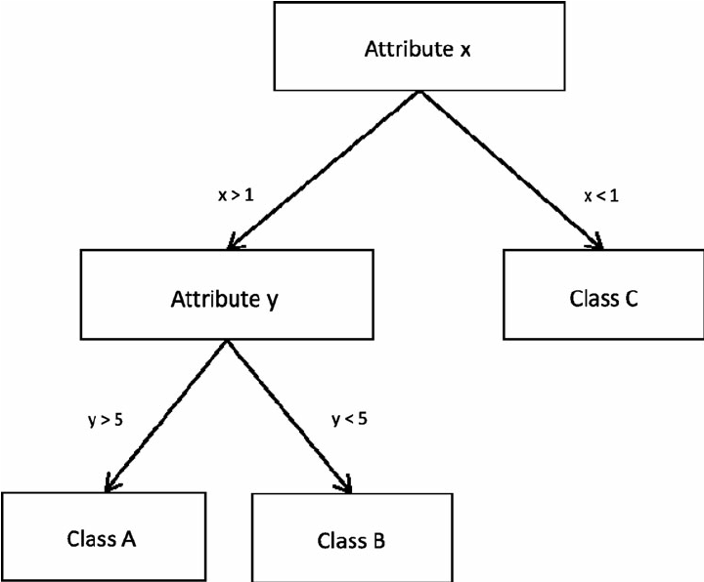
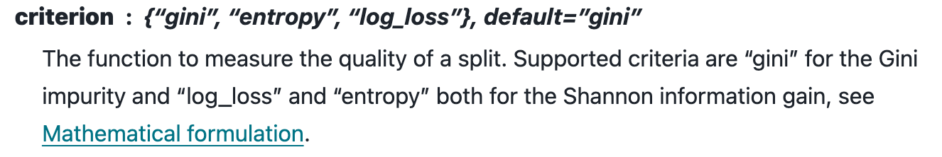
Decision tree classifier
Go through each variable and set a simple decision rule based on the features to predict value of a target variable
Can predict multiple classes
May be prone to overfitting (next week!)
Predictions are not smooth/continuous so they aren’t good at extrapolation
Greedy exhaustive search over all features and possible thresholds to minimize the criterion function
“Root node”
Keep splitting until each branch is “pure” (or close to pure)
https://scikit-learn.org/stable/modules/tree.html
Notes:
greedy top-down approach also known as recursive binary splitting to stratify the predictor space. What this algorithm tries to do is, starting at the top (a single region containing all observations) it tries to analyze all predictors and all cutpoint values for each predictor to choose the optimal set of predictors and cutpoint values that will have the least sum of squared error.
The sum of squared error here is the sum of squares of the difference between each observation in the split region and the mean response value of that region. This is the loss function that is being optimized.

Slide 13
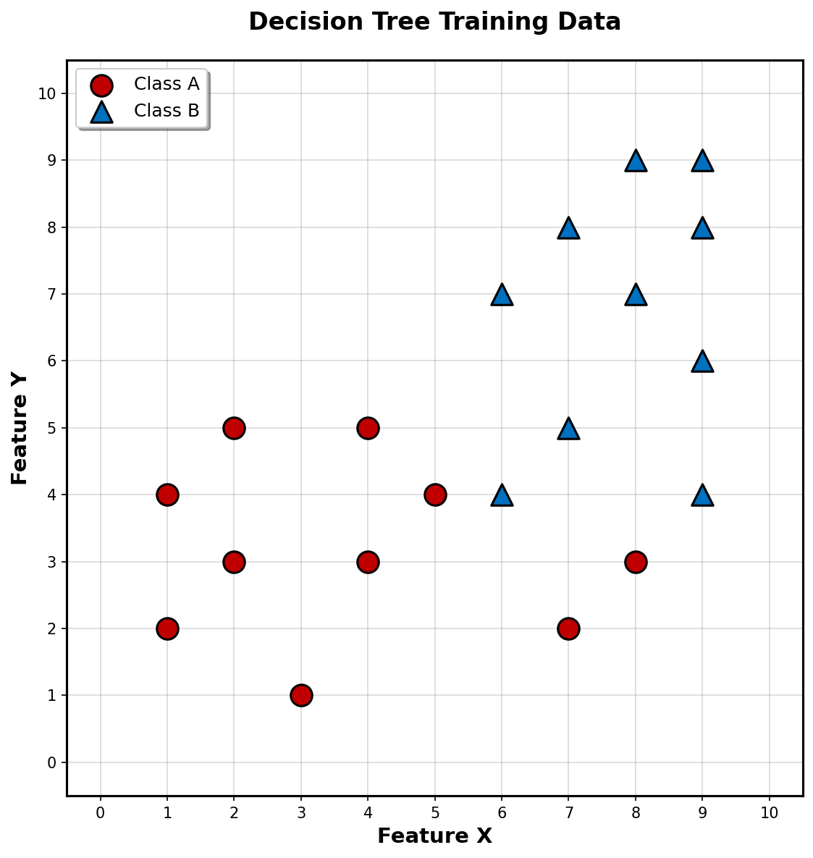
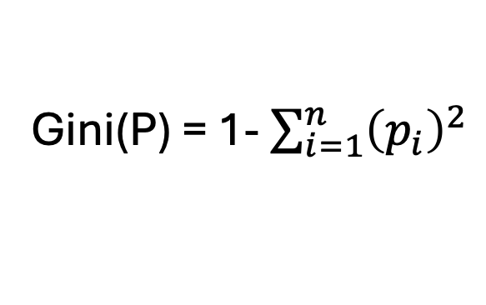
The gini coefficient for optimization
For two classes with class proportions p₁ and p₂:
Gini(P) = p₁p₂ + p₂p₁ = 2p₁p₂
Gini(P) = 1- $\sum_{i=1}^{n}{{\left(p_{i}\right)}^{2}}$
A measure of how mixed classes are in a region
Probability of being correctly assigned * probability of misclassification for each class
Minimum value = 0 when node is pure
Maximum value = 0.5 (probability of two classes are the same)
Notes:
Gini impurity is the summation of the product of pᵢ (probability of an item with label i being chosen) and 1 - pᵢ (probability of misclassification). The minimum value of Gini Index is 0 (when the node is pure, i.e. all the elements in the node are of one particular class).
Also, the maximum value is 0.5, and it is when the probability of the two classes are same.

Slide 14
The gini coefficient for optimization
For two classes with class proportions p₁ and p₂:
Gini(P) = p₁p₂ + p₂p₁ = 2p₁p₂
Gini(P) = 1- $\sum_{i=1}^{n}{{\left(p_{i}\right)}^{2}}$
A measure of how mixed classes are in a region
Probability of being correctly assigned * probability of misclassification for each class
Minimum value = 0 when node is pure
Maximum value = 0.5 (probability of two classes are the same)
Notes:
Gini impurity is the summation of the product of pᵢ (probability of an item with label i being chosen) and 1 - pᵢ (probability of misclassification). The minimum value of Gini Index is 0 (when the node is pure, i.e. all the elements in the node are of one particular class).
Also, the maximum value is 0.5, and it is when the probability of the two classes are same.

Slide 15
Logistic regression vs decision trees
Logistic regression
  Smooth linear or curved boundaries
  Good for small datasets
  Can use feature engineering to make non-linear features (like circle boundary)
Decision trees
  Complex, nonlinear interactions between features
  No feature engineering needed
  Easy to interpret
  Easy to overfit to your data; needs more data to avoid this

Slide 16
Using sci-kit learn
Check out the User Guide on sklearn website!
conda activate BME2315
pip install scikit-learn
from sklearn.linear_model import LinearRegression
from sklearn.linear_model import LogisticRegression
from sklearn.tree import DecisionTreeClassifier
https://scikit-learn.org/stable/modules/generated/sklearn.linear_model.LinearRegression.html

Slide 17
In class work time on your projects
Based on your PCA visualizations, your project goal, and your chosen method, decide on a model to use
  You will have a chance to make a better model next week, but feel free to ask for guidance on choosing a model!
Fit your model to your training dataset
Predict the target variable in the validation dataset
Choose some metrics to determine if your model is performing well on the validation dataset
  Visualize them with a plot (ROC curve? Confusion matrix? Something else?)
  Report in-sample error (on training set) and out-of-sample error (on validation set) and write out your thought process & conclusions: is your model performing well?
3rd check-in: All the red should be completed!

