Slide 1

Module 4
Lecture 2
Euler’s Method
Sarah Groves, Ph.D.
Shayn Peirce-Cottler, Ph.D.

Slide 2
Check-in: what R0 did you get? What virus family is close to this?

Slide 3

New information! Let’s practice pulling from upstream
In GitHub Desktop:
Fetch origin. If it says there are upstream changes, go ahead and pull them!
If not, choose a branch to merge into main → Choose upstream
If neither work:
  Right click on current repository → Open in terminal/command prompt
  Type git status (make sure you are in the right repo)
  Type git pull upstream main
If it still isn’t working, you may have forgotten to add my repository as upstream.

Slide 4
Next goal: predict peak of epidemic
What do we need to be able to predict the future?
Step 1: Figure out how to solve the SEIR model
Step 2: Fit a model to our data by picking good parameters
Step 3: Extrapolate past the data that we have to see when I(t) peaks in the model

Slide 5
Step 1: Solving the SEIR Model (with a numerical method)

Slide 6



How do we solve ODEs?
1) Guessing
E.g.: exponential growth/decay
*Note: I accidentally gave two correct solutions for a problem on your quiz with this structure!

Slide 7
How do we solve ODEs?
2) Separation of variables
example

Slide 8

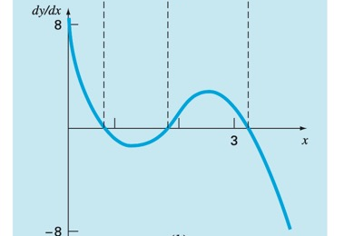
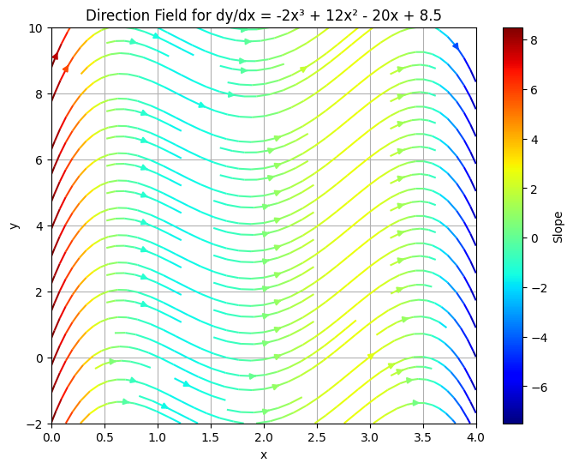
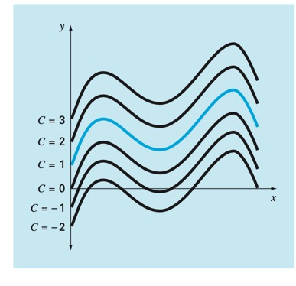
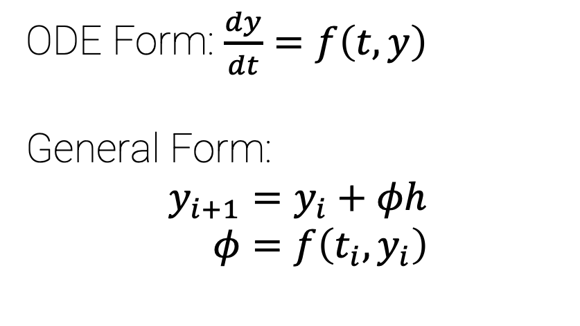
How do we solve ODEs?
The initial condition at x = 0 is y = 1.
We know:
y’=f(x) at any x, including y_{i}’ and y_{i+1}’
y(x_{i}) = y_{i}
We don’t know:
- y(x_{i+1}) = y_{i+1}
3. Numerical methods
ODE Form: $\frac{dy}{dt}=f\left(t,y\right)$
General Form:
$$y_{i+1}=y_{i}+φh \\ φ=f\left(t_{i},y_{i}\right)$$
True solution
Euler’s method

Slide 9
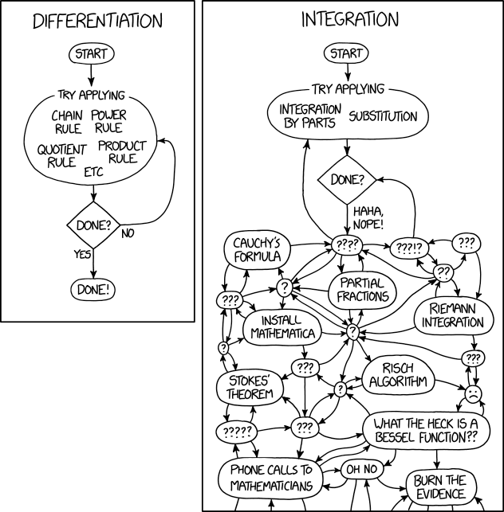
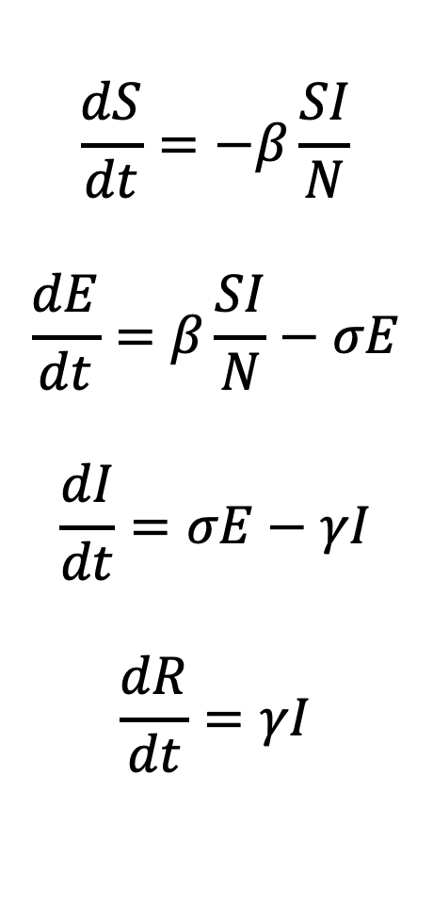
Solving Systems of ODEs
$$\frac{dS}{dt}=−β\frac{SI}{N}$$
$$\frac{dE}{dt}=β\frac{SI}{N}−σE$$
$$\frac{dI}{dt}=σE−γI$$
$$\frac{dR}{dt}=γI$$
Our system is autonomous and nonlinear
Can’t solve by guessing
Can’t solve by integration by parts
CAN approximate numerically with Euler’s method

Slide 10
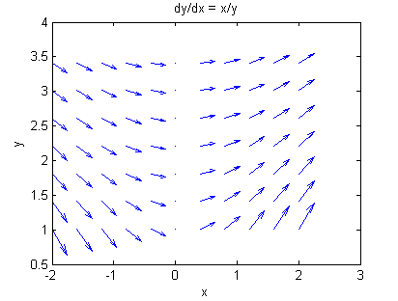
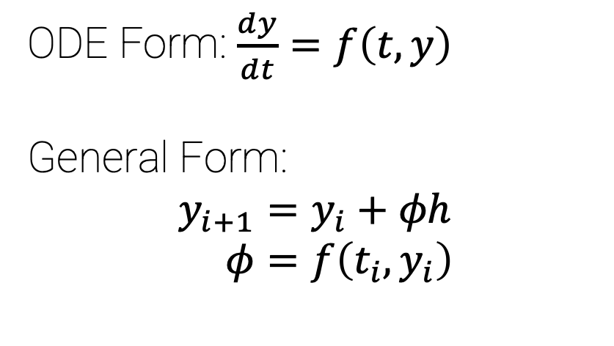
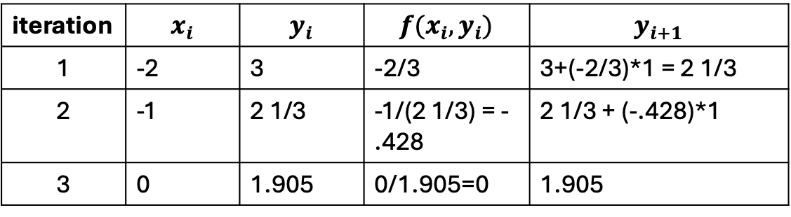


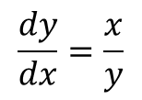
Euler’s Method Example
ODE Form: $\frac{dy}{dt}=f\left(t,y\right)$
General Form:
$$y_{i+1}=y_{i}+φh \\ φ=f\left(t_{i},y_{i}\right)$$
$$\frac{dy}{dx}=\frac{x}{y}$$
Solve y(x) using Euler’s method.
Notice our ODE is dependent on the independent and dependent variables here!
I.C.
$$y\left(x=−2\right)=3$$
$$h=1$$
iteration | $$x_{i}$$ | $$y_{i}$$ | $$f(x_{i},y_{i})$$ | $$y_{i+1}$$
1 | -2 | 3 | -2/3 | 3+(-2/3)*1 = 2 1/3
2 | -1 | 2 1/3 | -1/(2 1/3) = -.428 | 2 1/3 + (-.428)*1
3 | 0 | 1.905 | 0/1.905=0 | 1.905
Notes:
-2
3
-2/3
3-2/3 = 2 1/3
-1
2 1/3
-1/2.33 = -0.428
2 1/3 – 0.428 = 1.905

Slide 11
Pseudocode for Euler’s Method Approximation of SEIR
INPUTS: beta, sigma, gamma, S0, E0, I0, R0, timepoints, N
Initialize S, E, I, and R as empty arrays or lists
Set first item in each list equal to initial values S0, E0, I0, R0
For each timepoint in timepoints:
  Calculate the four derivatives at timepoint
  Calculate S, E, I, and R at timepoint + 1 using Euler’s method
Return S, E, I, and R

Slide 12
Step 2: Fitting the SEIR Model (using optimization)

Slide 13
Fitting the SIR Model Parameters using Euler’s Method
$$\frac{dS}{dt}=−β\frac{SI}{N}$$
$$\frac{dE}{dt}=β\frac{SI}{N}−σE$$
$$\frac{dI}{dt}=σE−γI$$
$$\frac{dR}{dt}=γI$$
Our goal: get S(t), E(t), I(t), and R(t) using Euler’s method
These solutions will depend on our parameters, beta, sigma, and gamma
  We can choose different values of the parameters to try to match our actual dataset
In other words, we will combine Euler’s method with optimization of SSE to pick best beta, sigma, and gamma for our dataset

Slide 14
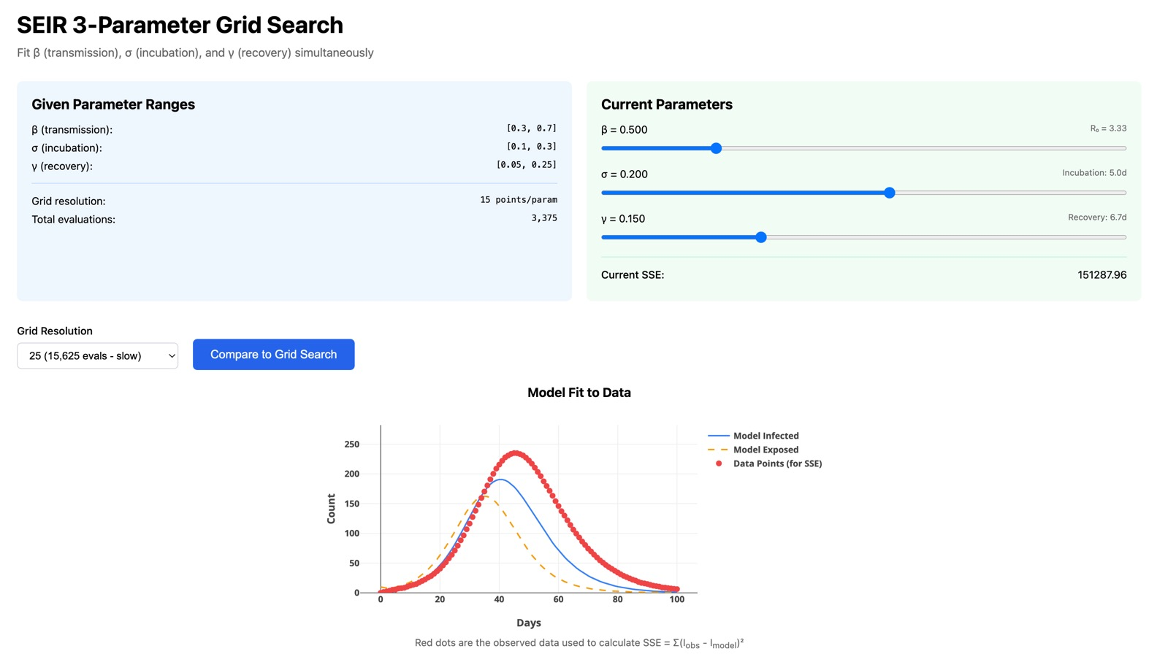
Using the data (red), change the parameters until the model I(t) (blue) matches the data
With your partner, discuss:
  How does changing beta affect the model curve? Sigma? Gamma?
  How can you use the “current SSE” values to tell if you are getting closer to the best fit?
  Which resolution for the grid search is best?

Slide 15
Grid search optimization pseudocode
INPUTS: timepoints, N, S0, E0, I0, R0, data
Initialize a range for beta, sigma, and gamma
Initialize an empty array of SSE
Make arrays of values given each range for each parameter
For b in beta
  For s in sigma
    For g in gamma
      Use the Euler method function you developed to calculate S, E, I, and R given those parameters
      Calculate the SSE given the model results and the data and append this to the SSE array
Determine parameters corresponding to lowest SSE
Return best_beta, best_sigma, and best_gamma and corresponding SSE
HINT: Use R0 you calculated and the info we have to pick a good range!

Slide 16
Step 3: Predict the future

Slide 17
Predicting the peak
INPUTS: best_beta, best_sigma, best_gamma
Use the Euler method to run the model out many more days until the data peaks
How high is the peak? Is that a reasonable value?
What day will the peak occur?

Slide 18
Next steps in your code
Implement Euler’s method for SEIR modeling
Plot Euler’s method solutions for I(t) and compare to your data
Guess beta, sigma, and gamma and calculate SSE

Slide 19
HOMEWORK
DUE TOMORROW at midnight: GitHub Check in #1
  Includes code from last Thursday and Tuesday (only working on data release #1)
  If you have new code from today in your repo, don’t worry. We will find the code related to check-in #1
  Reference .py files in Code folder to ensure you have everything you need
  You should also have plots, explanations, etc. Tell us your thought process!
Due March 9 MIDNIGHT (After spring break): GitHub Check in #2
  Including only code from today’s class

